Slide 1

Cyclistic Case Study
Defining the Differences Between Casual Riders and Annual Members
Daniel Prashad
April 2024
All data used in this analysis was collected from March 2023 to February 2024

Slide 2
Business Task & Initial Hypothesis
Cyclistic’s overall objective
Develop a marketing strategy to convert casual riders to annual members
First step carried out in this analysis
Define the differences between how casual riders and annual members use Cyclistic bikes
Initial hypothesis
Annual members are more likely to use Cyclistic bike to commute to and from work
Casual riders are more likely to use Cyclistic bikes for leisure

Slide 3
What Does Riding For Leisure Look Like?
Weather
Casual riders prefer better weather conditions
Day and Time
Casual riders prefer to ride on the weekends
Annual members ride more during the week and during common commuting hours
Duration and Distance
Casual riders ride longer than annual members
The difference in distance between start and end station for each group is negligible

Slide 4
Defining the Metrics Used
Weather
Season and month of when the ride was started
Day and Time
Day of week and hour of day when the ride was started
Duration and Distance
Duration: total time spent from when the bike was picked up until it was dropped off
Distance: distance between where the bike was picked up and dropped off

Slide 5
Weather
Weather
Casual riders prefer better weather conditions
Day and Time
Casual riders prefer to ride on the weekends
Annual members ride more during the week and during common commuting hours
Duration and Distance
Casual riders ride longer than annual members
The difference in distance between start and end station for each group is negligible

Slide 6
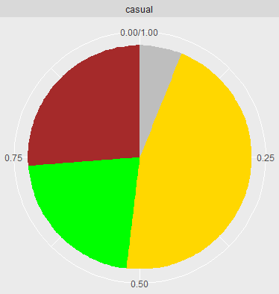
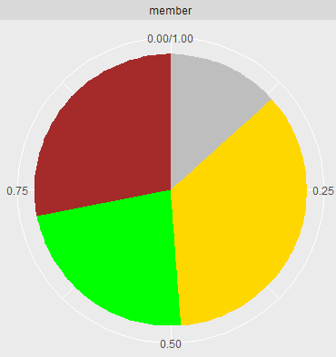
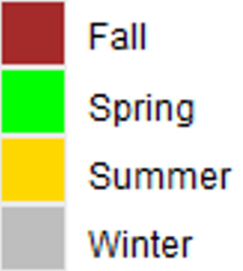
Total Number of Rides by Season
Casual riders prefer riding more in the Summer and less in the Winter than members.
Membership Status | Season | Total Rides | Percentage
casual | Fall | 392662 | 26.25
casual | Spring | 326960 | 21.85
casual | Summer | 685554 | 45.82
casual | Winter | 90943 | 6.08
Membership Status | Season | Total Rides | Percentage
member | Fall | 771650 | 28.1
member | Spring | 634632 | 23.11
member | Summer | 974697 | 35.49
member | Winter | 365561 | 13.31

Slide 7
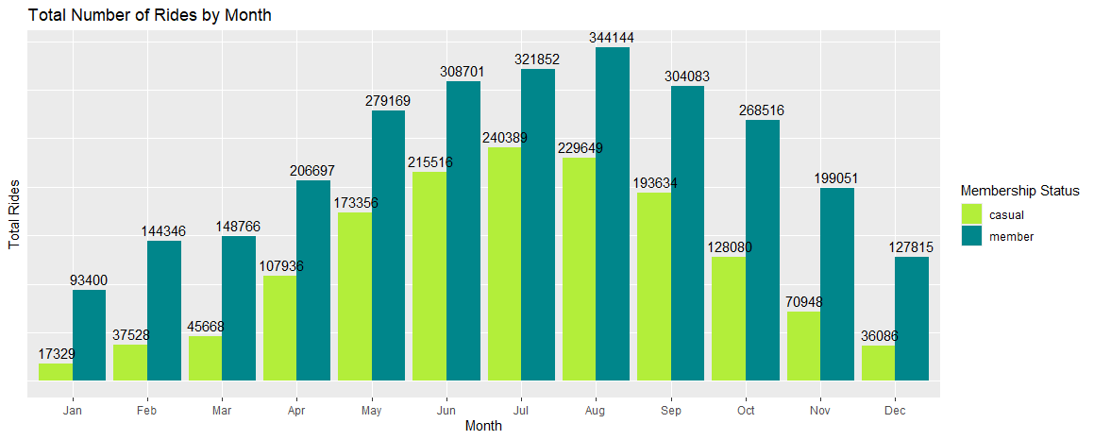
Total Number of Rides by Season
May to September:
The percentage of rides by casual members is higher than annual members
October to April:
The percentage of rides by annual members is higher than casual riders
Month | Membership Status | Percentage
Jan | casual | 1.16
 | member | 3.4
Feb | casual | 2.51
 | member | 5.26
Mar | casual | 3.05
 | member | 5.42
Apr | casual | 7.21
 | member | 7.53
May | casual | 11.59
 | member | 10.16
Jun | casual | 14.41
 | member | 11.24
Jul | casual | 16.07
 | member | 11.72
Aug | casual | 15.35
 | member | 12.53
Sep | casual | 12.94
 | member | 11.07
Oct | casual | 8.56
 | member | 9.78
Nov | casual | 4.74
 | member | 7.25
Dec | casual | 2.41
 | member | 4.65

Slide 8
Weather Summary
Annual members are more likely to ride despite harsher weather conditions
Casual riders prefer better weather conditions more than annual members
Casual riders more strongly opt to ride in the Summer
Casual riders are more likely to use bikes from May to September than members
This is likely because the temperature and lack of precipitation are more suitable for a leisurely ride

Slide 9
Day and Time
Weather
Casual riders prefer better weather conditions
Day and Time
Casual riders prefer to ride on the weekends
Annual members ride more during the week and during common commuting hours
Duration and Distance
Casual riders ride longer than annual members
The difference in distance between start and end station for each group is negligible

Slide 10
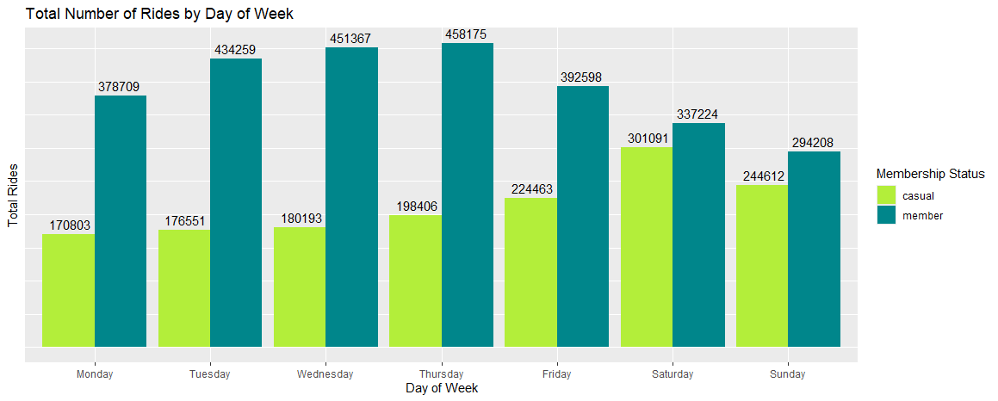
Total Number of Rides by Day
Most rides from casual riders occur on the weekend
Most rides from annual members occur during the week
Day | Membership Status | Percentage
Monday | casual | 11.42
 | member | 13.79
Tuesday | casual | 11.8
 | member | 15.81
Wednesday | casual | 12.04
 | member | 16.43
Thursday | casual | 13.26
 | member | 16.68
Friday | casual | 15
 | member | 14.29
Saturday | casual | 20.12
 | member | 12.28
Sunday | casual | 16.35
 | member | 10.71

Slide 11
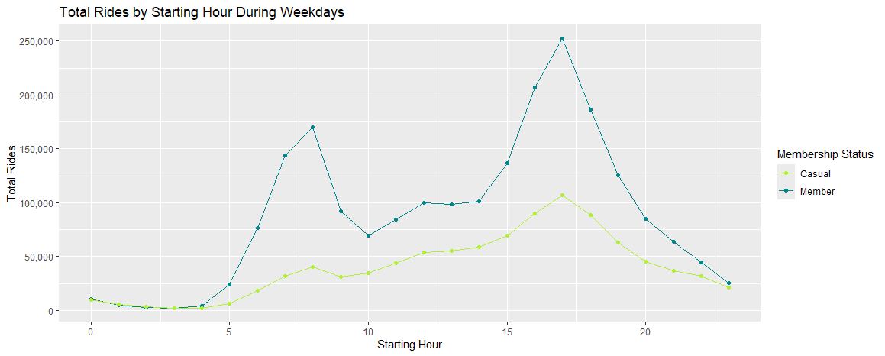
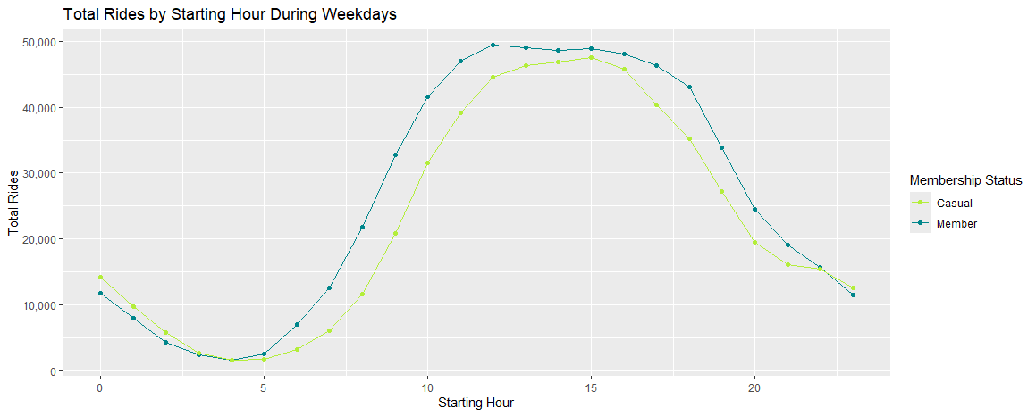
Total Number of Rides by Hour
Weekdays
Both groups have a peak in rides started from 4:00pm to 6:00pm
Annual members have another peak from 7:00am to 8:00am
Weekends
Both groups show a similar trend throughout the day

Slide 12
Day and Time Summary
Casual riders ride more frequently on the weekends
Annual members ride more frequently during the week
And have a peak in rides started from 7:00am to 8:00am on weekdays (common commuting hours)
Both groups show similar riding habits during weekends

Slide 13
Duration and Distance
Weather
Casual riders prefer better weather conditions
Day and Time
Casual riders prefer to ride on the weekends
Annual members ride more during the week and during common commuting hours
Duration and Distance
Casual riders ride longer than annual members
The difference in distance between start and end station for each group is negligible

Slide 14
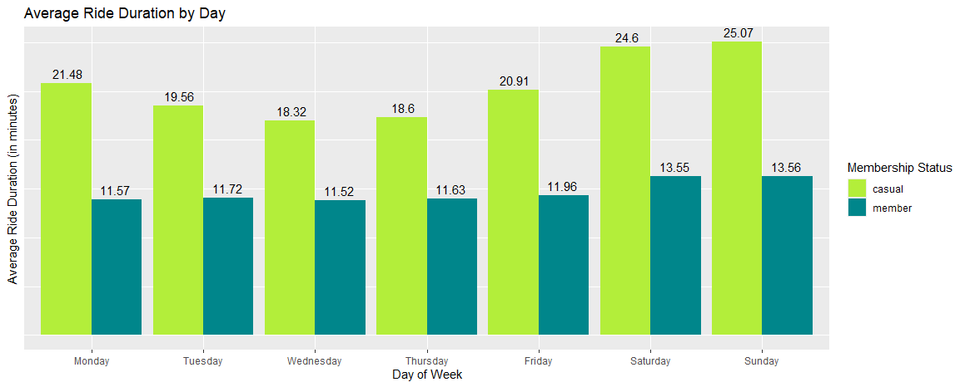
Duration
On average, casual riders spend almost twice as long per ride than members
Members show little variance in average duration during the week

Slide 15
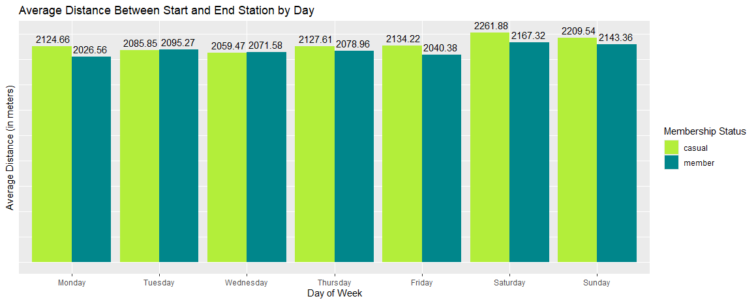
Distance
The average distance between start and end stations for casual riders is slightly more than members
Note: This distance is not the total distance ridden

Slide 16
Why Is the Difference in Duration Significant, but Distance Not?
Casual riders spend much longer per ride, but do not end their rides much further than annual members
The three possible cases leading to this are that casual riders are more likely to:
Ride at a slower and more leisurely pace
Spend more time riding and cover more total distance, but end closer to their start station; not taking a direct route
Start and end at the same station
Membership Status | Number of 0 Distance Rides | Percentage
member | 49230 | 1.79
casual | 89025 | 5.95

Slide 17
Duration and Distance Summary
On average, casual riders spend almost twice as long per ride than members
Casual riders do not end their rides much further than members
This could be because they are more likely to:
Ride at a slower and more leisurely pace
Not take a direct route
Start and end at the same station

Slide 18
Conclusion
Annual members are more likely to use Cyclistic bike to commute to and from work
More likely to ride despite harsh weather
Influx of rides during common commuting hours
Casual riders are more likely to use Cyclistic bikes for leisure
Opt for better weather conditions
Prefer to ride on weekends
Spend a longer time riding
More likely to start and end at the same station

Slide 19
The Next Step
Collect additional data to reaffirm conclusions drawn
In order to better track habits of a single rider
Employ a randomly generated Rider ID for each user
To better describe the relationship between each group and weather
Collect temperature and precipitation (dry/rain/snow) for the start of each trip
To better understand the relationship between duration and distance
Collect the total distance ridden during each ride

Slide 20
Thank You

